Slide 1
Multimodal Gloves Experiment
[ 07.11.2025 ]
Azimjon Akhtamov
Department of Computer Science, CBNU

Slide 2
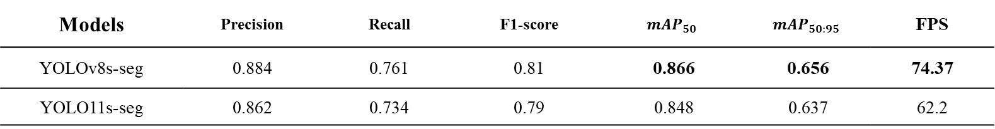
Performance Comparison of segmentation models
YOLO-based Instance Segmentation
Models | Precision | Recall | F1-score | $${mAP}_{50}$$ | $${mAP}_{50:95}$$ | FPS
YOLOv8s-seg | 0.884 | 0.761 | 0.81 | 0.866 | 0.656 | 74.37
YOLO11s-seg | 0.862 | 0.734 | 0.79 | 0.848 | 0.637 | 62.2
Instance Segmentation
Models | Backbone | $${mAP}_{50:95}$$ | $${mAP}_{50}$$ | $${mAP}_{70}$$ | $${mAP}_{95}$$ | FPS
YOLACT | ResNet-50 | 0.438 | 0.711 | 0.499 | 0.36 | 46.7
SUMMARY: YOLOv8s-seg model performed well both accuracy & speed
Inference Speed (FPS): 512×512 resolution [ NVIDIA TITAN RTX ]

Slide 3
EXPERIMENT 1: Proximity-based Fusion
Model | Yolo8s-pose | Yolo11s-pose | RTMPose-s | Gloves F1-score | No Gloves F1-score | FPS
Yolov8s-seg |  |  |  | 0.828 | 0.755 | 74.37
 |  | ✓ |  | 0.849 | 0.765 | 40.68
 | ✓ |  |  | 0.856 | 0.765 | 42.3
 |  |  | ✓
Model | Yolo8s-pose | Yolo11s-pose | RTMPose-s | Gloves F1-score | No Gloves F1-score | FPS
Yolo11s-seg |  |  |  | 0.808 | 0.731 | 62.2
 |  | ✓ |  | 0.826 | 0.740 | 39.15
 | ✓ |  |  | 0.832 | 0.738 | 20.92
 |  |  | ✓

Slide 4
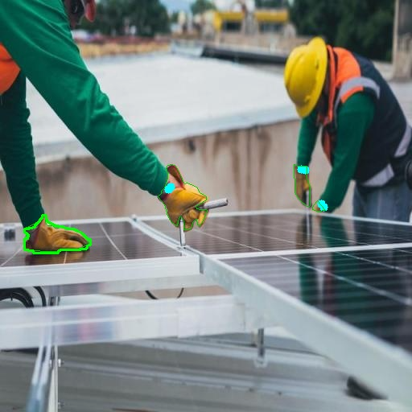
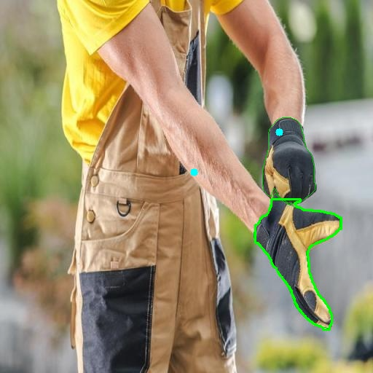
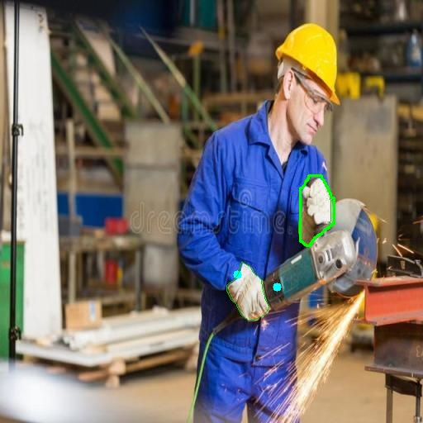
Wrist | Failure Cases
Yolov8s-pose & Yolo11s-pose: Missing wrist keypoints and wrong localization.

Slide 5
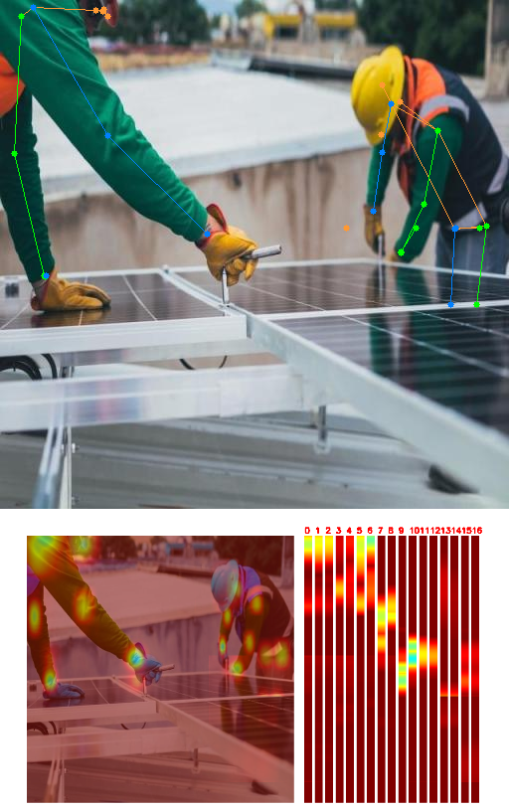
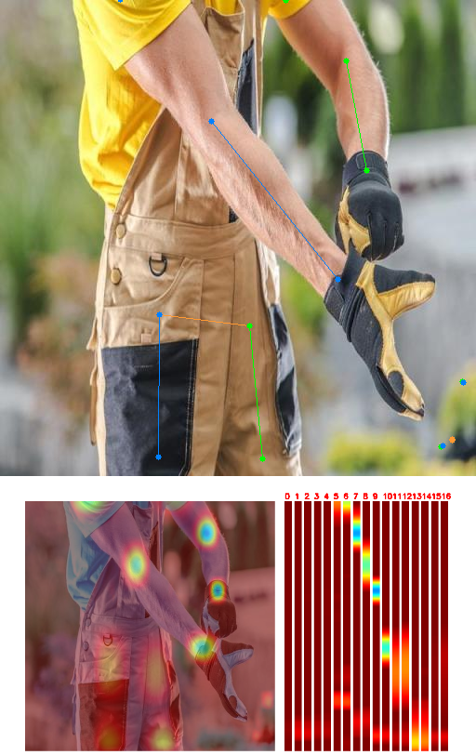
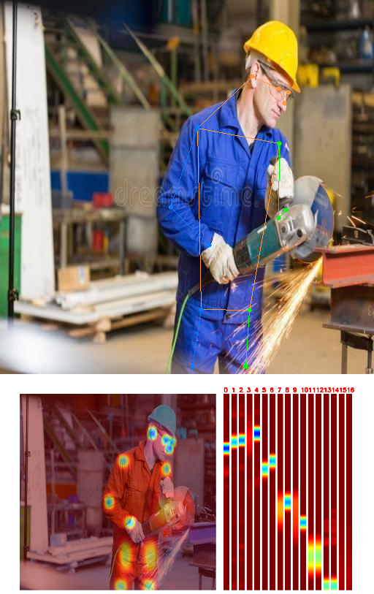
RTMPose | Qualitative Cases

Slide 6
Greetings

